Slide 1


Bridging Entertainment and Learning
Prashanthi Koudi Akshar Patel Keerthi Reddy Ellanki

Slide 2
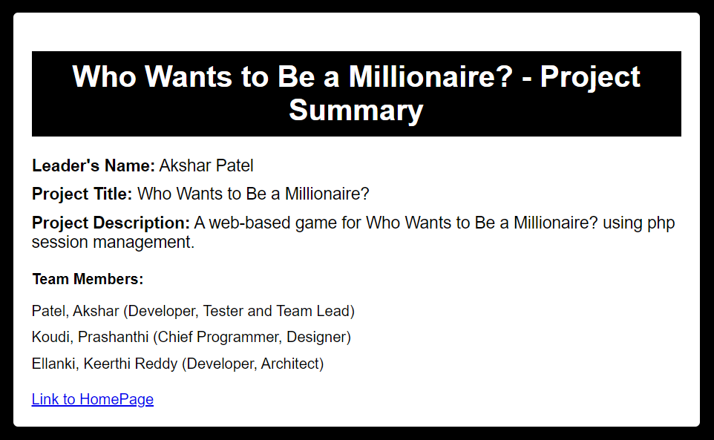
PROJECT SUMMARY PAGE

Slide 3
Problem Statement
Current educational platforms lack the engaging and entertaining methods required to make learning more interactive and enjoyable. Many existing systems often focus on information delivery rather than providing an engaging and immersive experience.
Traditional learning methods might lack the appeal needed to capture and retain users' interest. There's a need to bridge the gap between education and entertainment to create a more engaging learning environment.
Users seek a platform that not only imparts knowledge but also entices and challenges them in an enjoyable and rewarding manner. They're looking for an educational experience that is as captivating as it is informative.

Slide 4
Solution Overview
The project offers a web-based game inspired by the popular show "Who Wants to Be a Millionaire." It allows users to register, log in, and engage in a series of multiple-choice questions to accumulate score based on their correct answers.
The project aims to transform the educational experience into an engaging game, providing users with a fun and challenging platform to test their knowledge.
By integrating a game show format with educational content, the platform provides an immersive learning experience, encouraging users to participate actively and enhancing their retention of information.

Slide 5
Key features
User Authentication:
Enables users to create personalized accounts, facilitating the tracking of their progress and scores within the game.
Multiple-Choice Questions:
Offers a diverse range of questions spanning different difficulty levels, ensuring an engaging and intellectually stimulating experience.
Scoring & Earnings:
Users earn virtual earnings for each correct answer, fostering motivation to aim for higher scores, while an incorrect answer concludes the game.
Leaderboard:
Showcases user’s earnings, and the dates of their gameplay, motivating them to improve their performance.

Slide 6
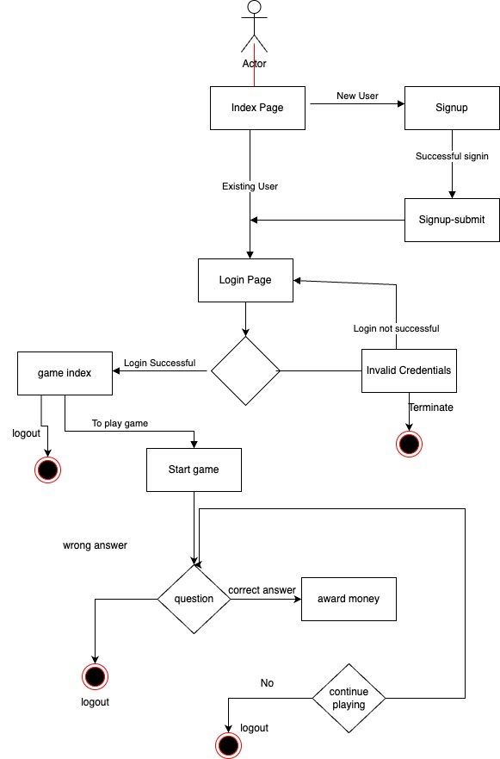
UML Diagram

Slide 7
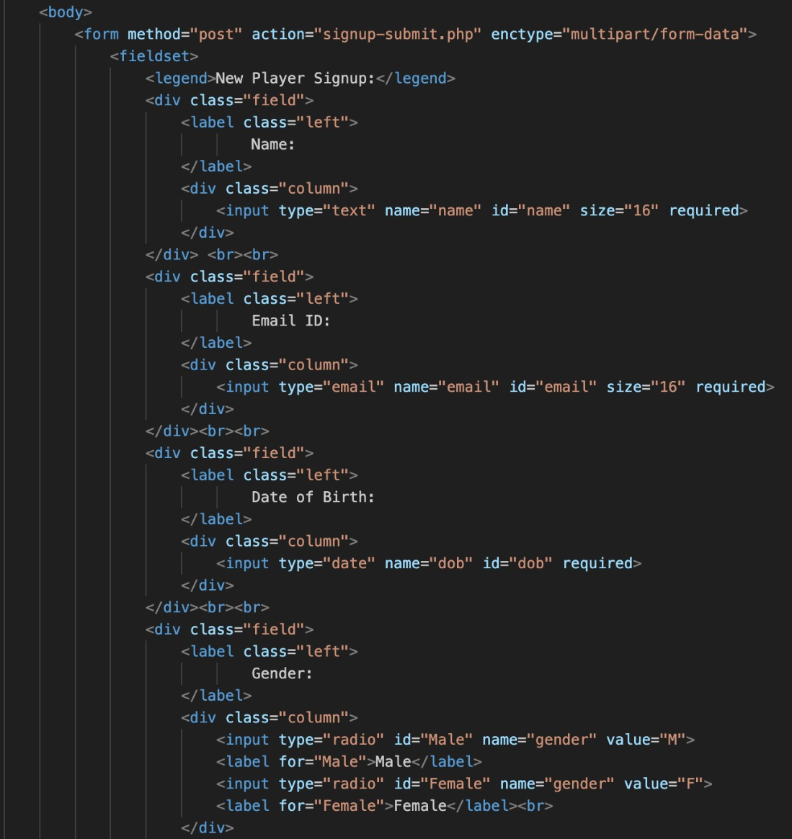
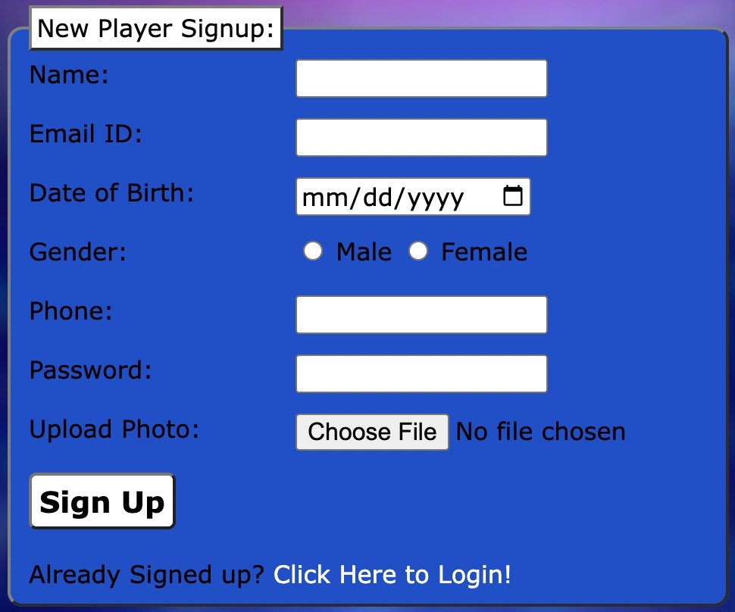
Code snippets

Slide 8
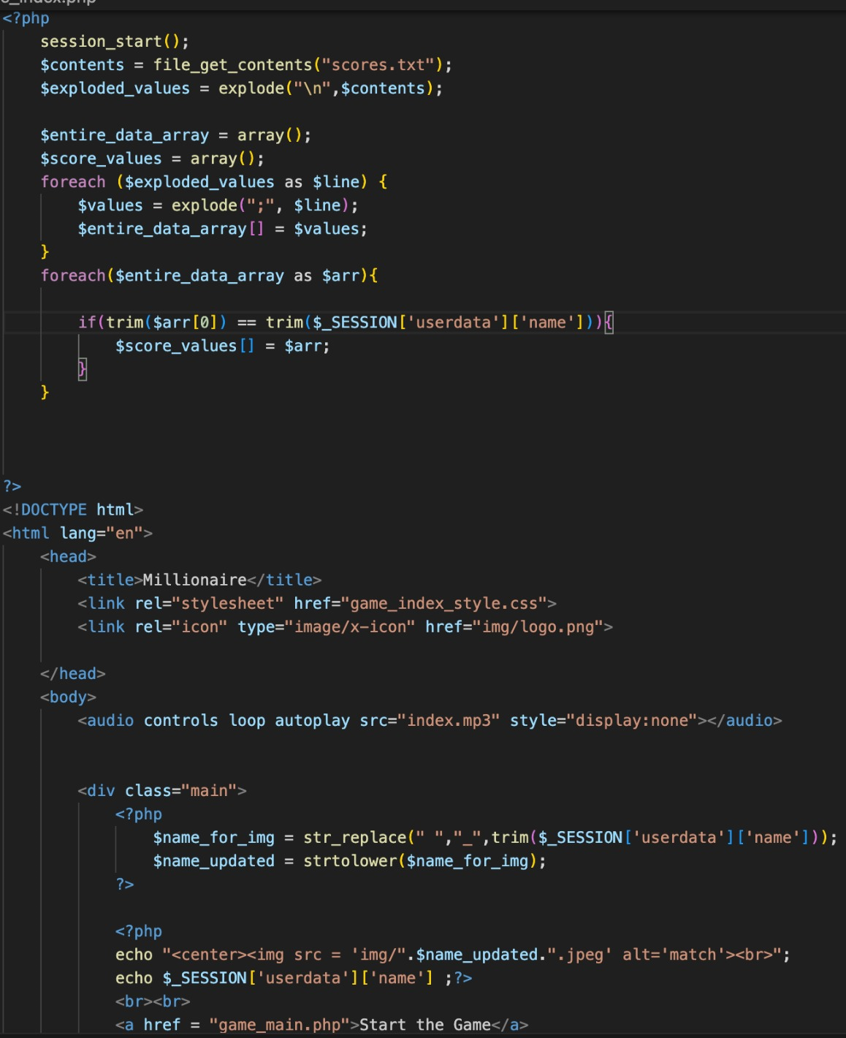
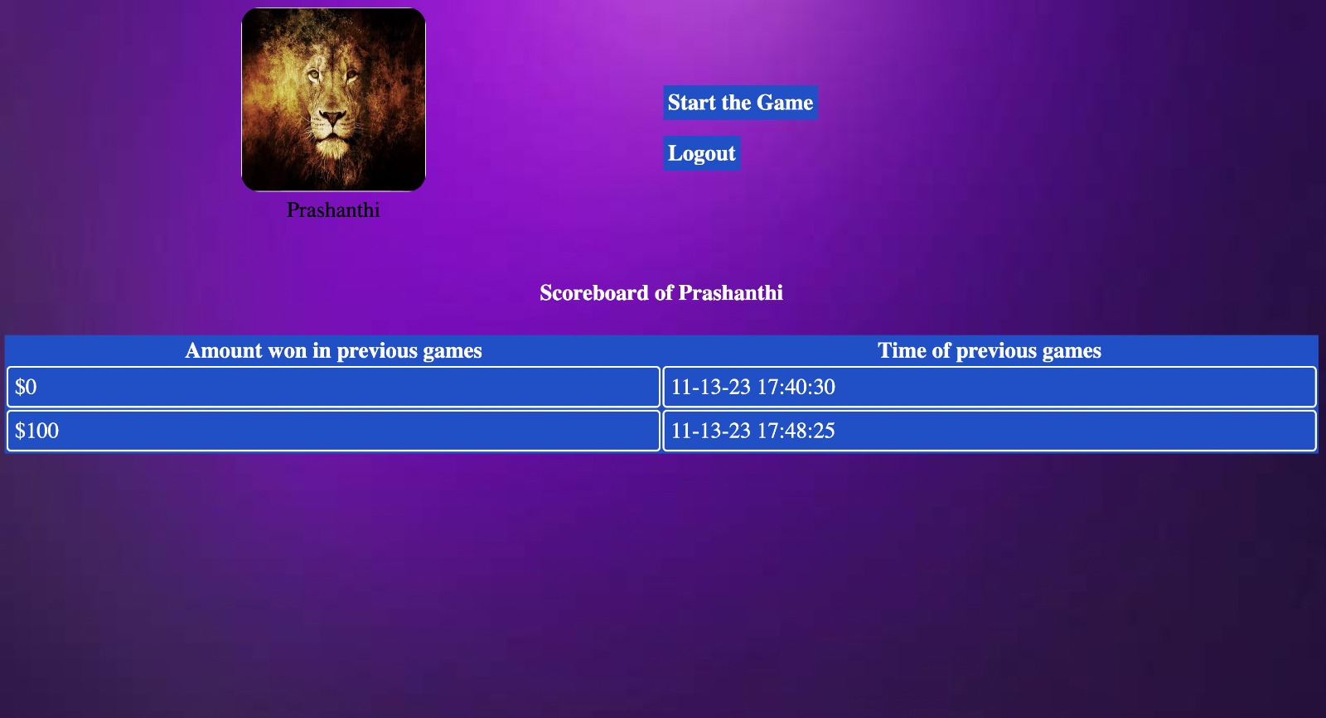
Contd…

Slide 9
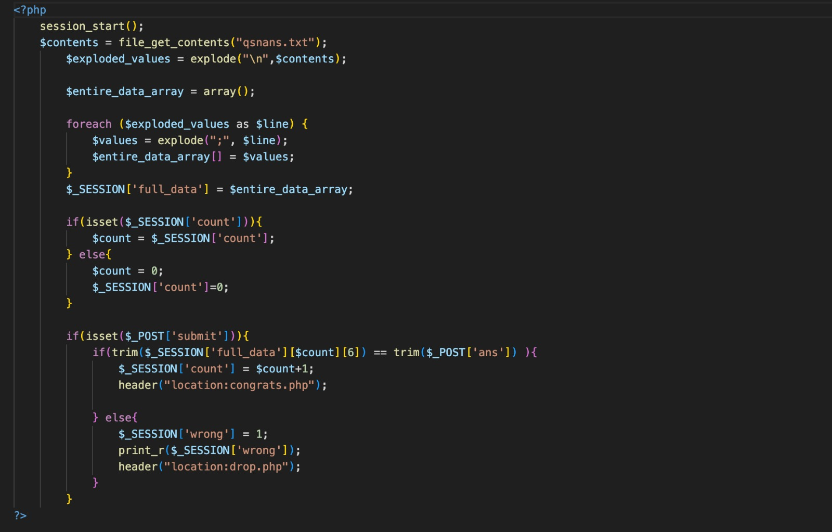
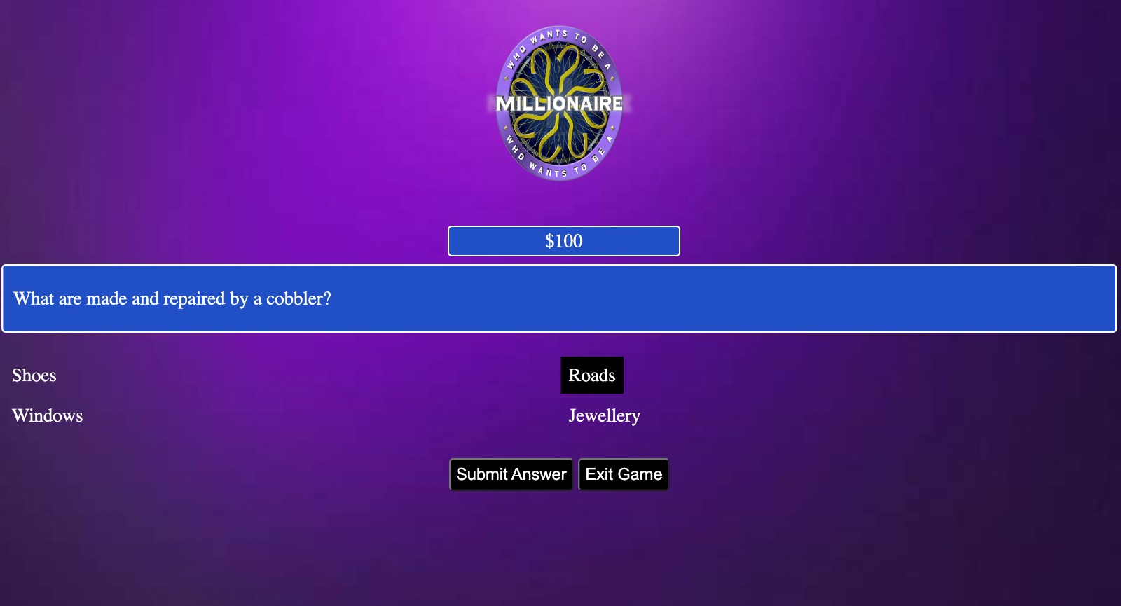
Contd…

Slide 10
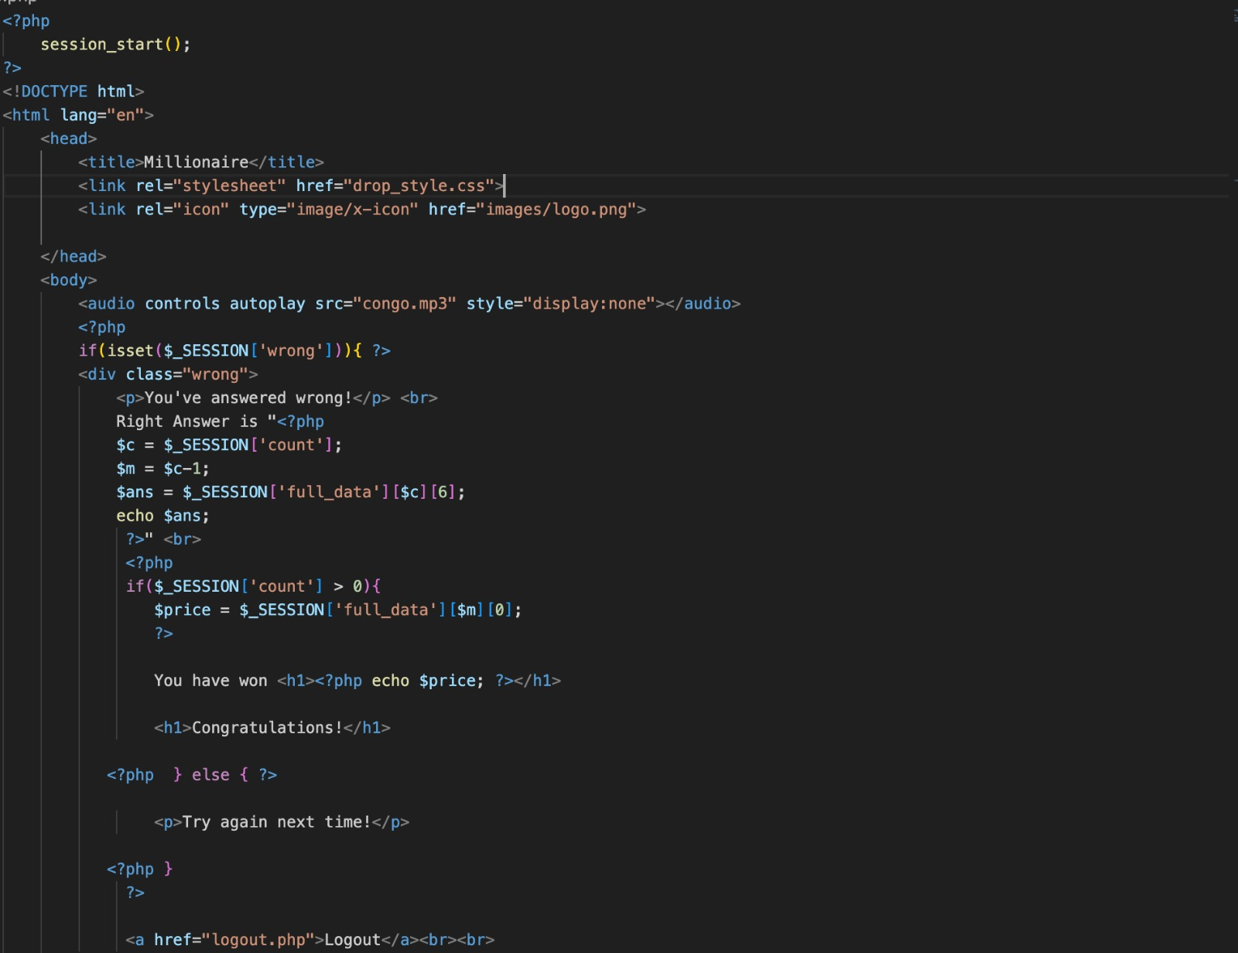
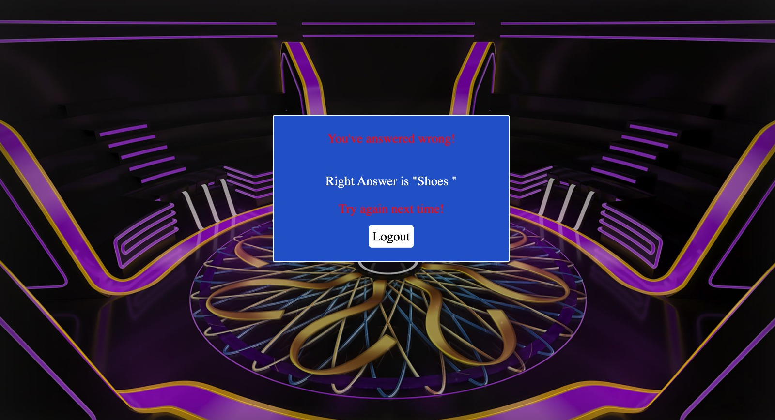
Contd…

Slide 11
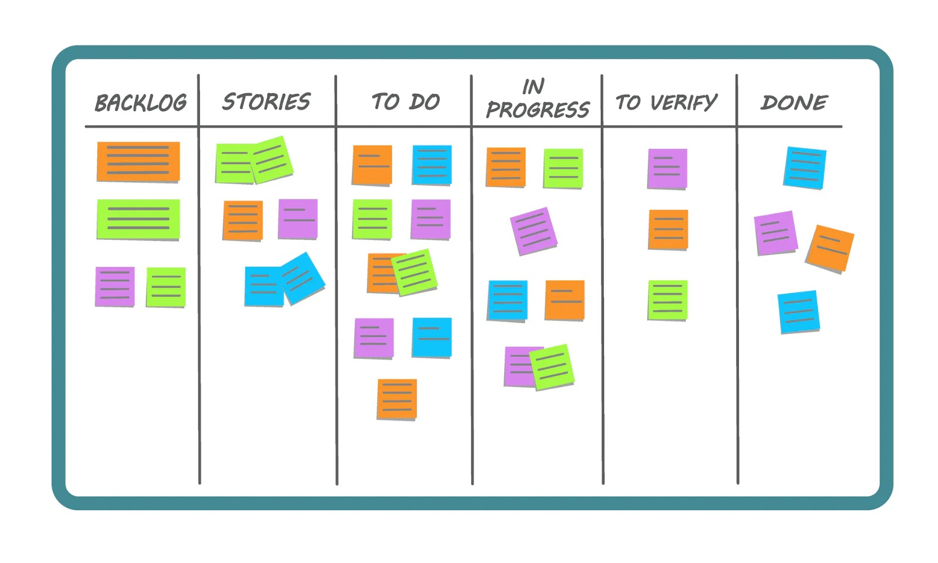
Scrum Methodology
Workflow stages –
Team Collaboration & Requirements Gathering
Basic Design
Brainstorming Ideas
Logic and development of Game and scoreboard.
Testing

Slide 12
Testing
Unit Testing to see if the questions are displaying properly
Testing on sessions
User credentials
Properties of image folder
Testing to see if the displayed answer is correct or not.

Slide 13
Link to project home page-
https://codd.cs.gsu.edu/~apatel392/wp/project/2/index.php
Link to project summary page –
https://codd.cs.gsu.edu/~apatel392/wp/project/2/info.html
Link to YouTube ppt presentation –
https://youtu.be/YeUaACGlWLE?si=Xmu7UAPpxnmEOktM
Link to GitHub Repository –
https://github.com/akshar-26/Project-2

Slide 14


